Slide 1
The Warriors
Project: Predicting forest fires
Members:
Rafael Brennand
Travis Molnoskey
Brenda Mitchell
Trevor Haney

Slide 2
Agenda
Introduction/Charter Objectives
Data Gathering: Trevor
Data Formulating:
Data Visualization:
Results:

Slide 3
Data Gathering: The search for less data
Source: Keggle
Two sources, one source had gigbytes of data but stored in SQLlite format
Source: National Oceanic and Atmospheric Administration (NOAA)
Restricted timeframe from 2005 – 2015
Data parameters: Comparing number of fires and acres burned with temperature max, wind speed, latitude, precipitation, season, and cause
Notes:
Talk about the massive amount of data we found so we had to restrict the data we used
NOAA ties in networks of weather information: https://www.ncdc.noaa.gov/cdo-web/results
NOAA API uses a token in place of an API key

Slide 4
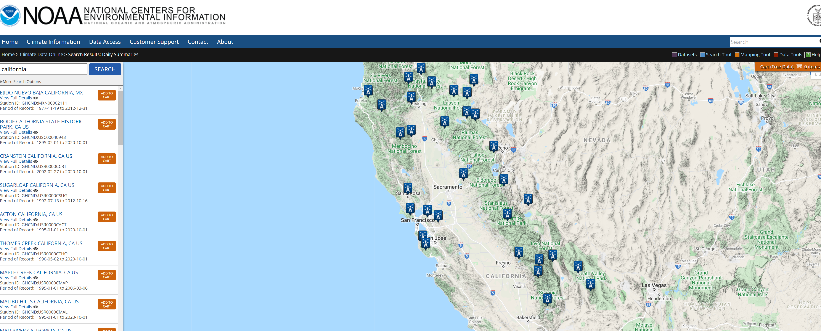
Data Gathering: The search for less data

Slide 5
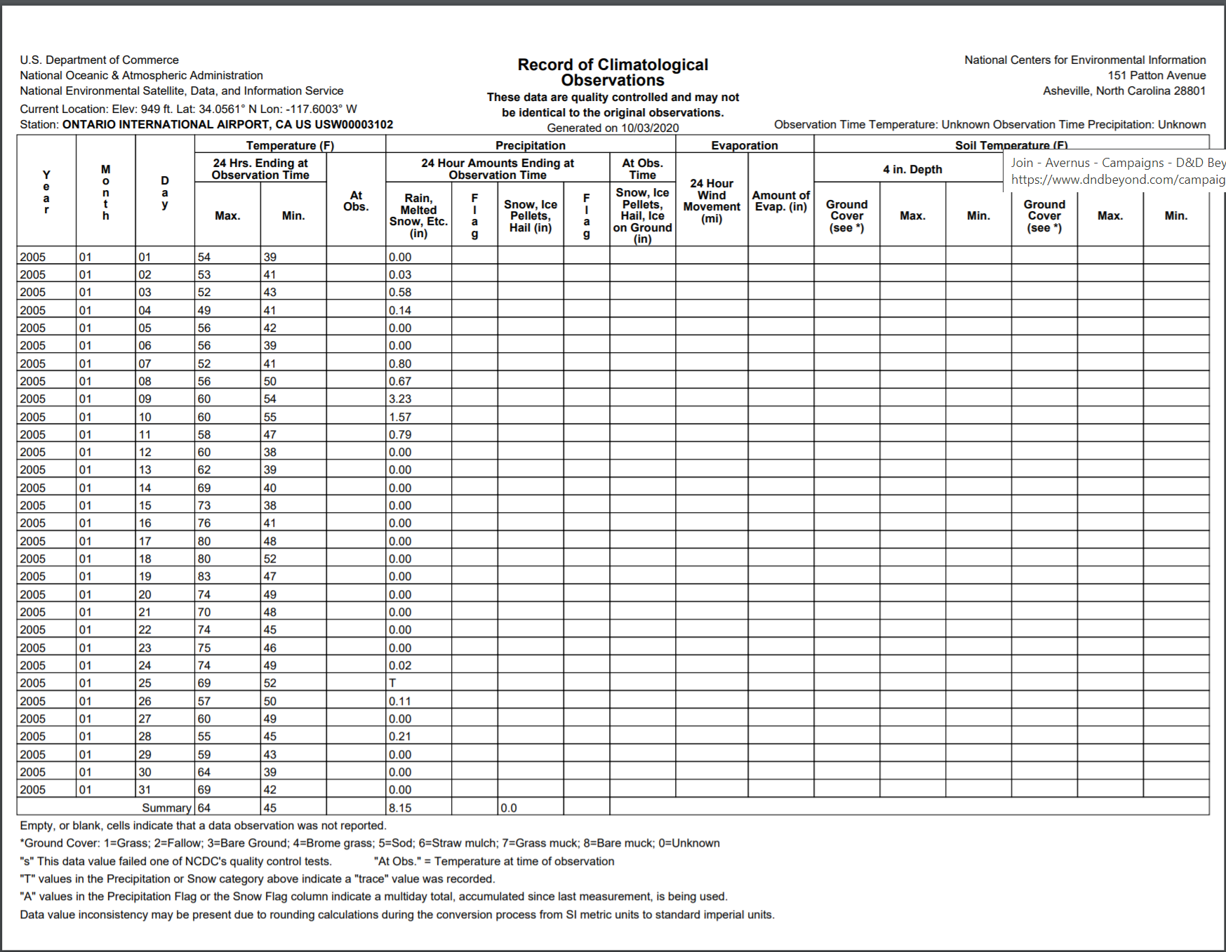
Data Gathering: The search for less data

Slide 6
Questions??

